Slide 1
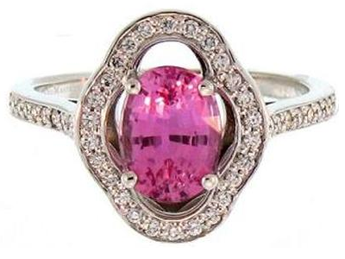
Production Line Analysis - Rings
Colormasters Precious Jewelry
Jason Heller

Slide 2
Objective
Analyze the dataset provided by Colormasters
Make observations of the data based on production time
Identify bottlenecks in the production process
Make recommendations based on our observations

Slide 3
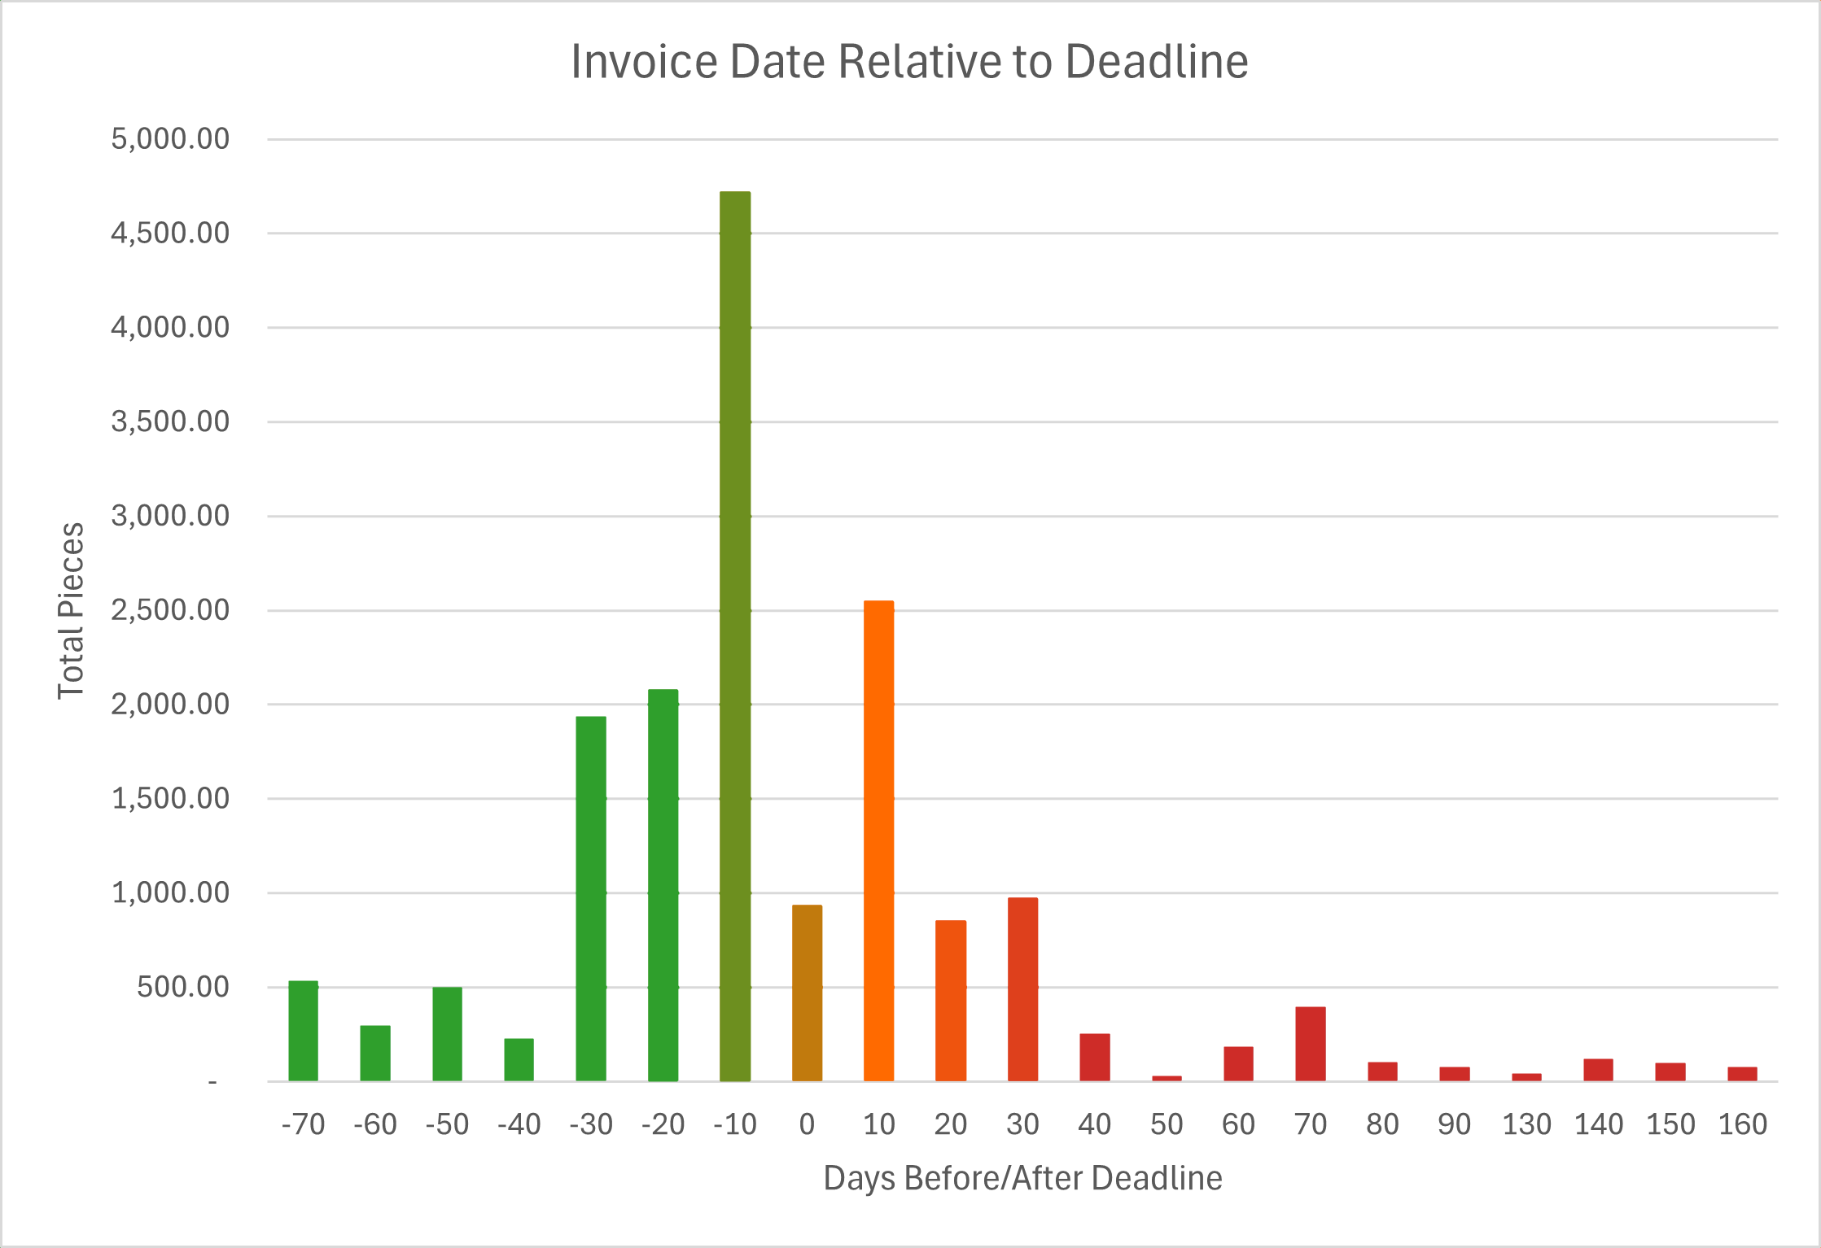

Slide 4
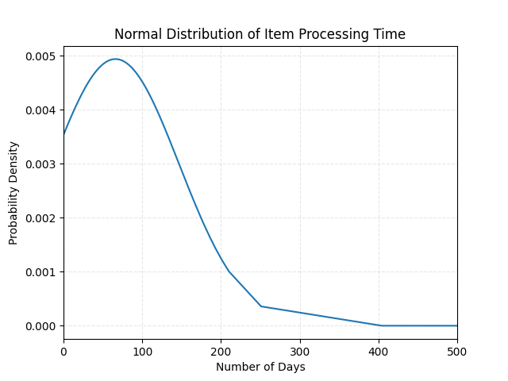

Slide 5
Method
Analyze the dataset provided by Colormasters
Make observations of the data based on production time
Identify bottlenecks in the production process
Make recommendations based on our observations

Slide 6
Observations of Shank Size

Slide 7
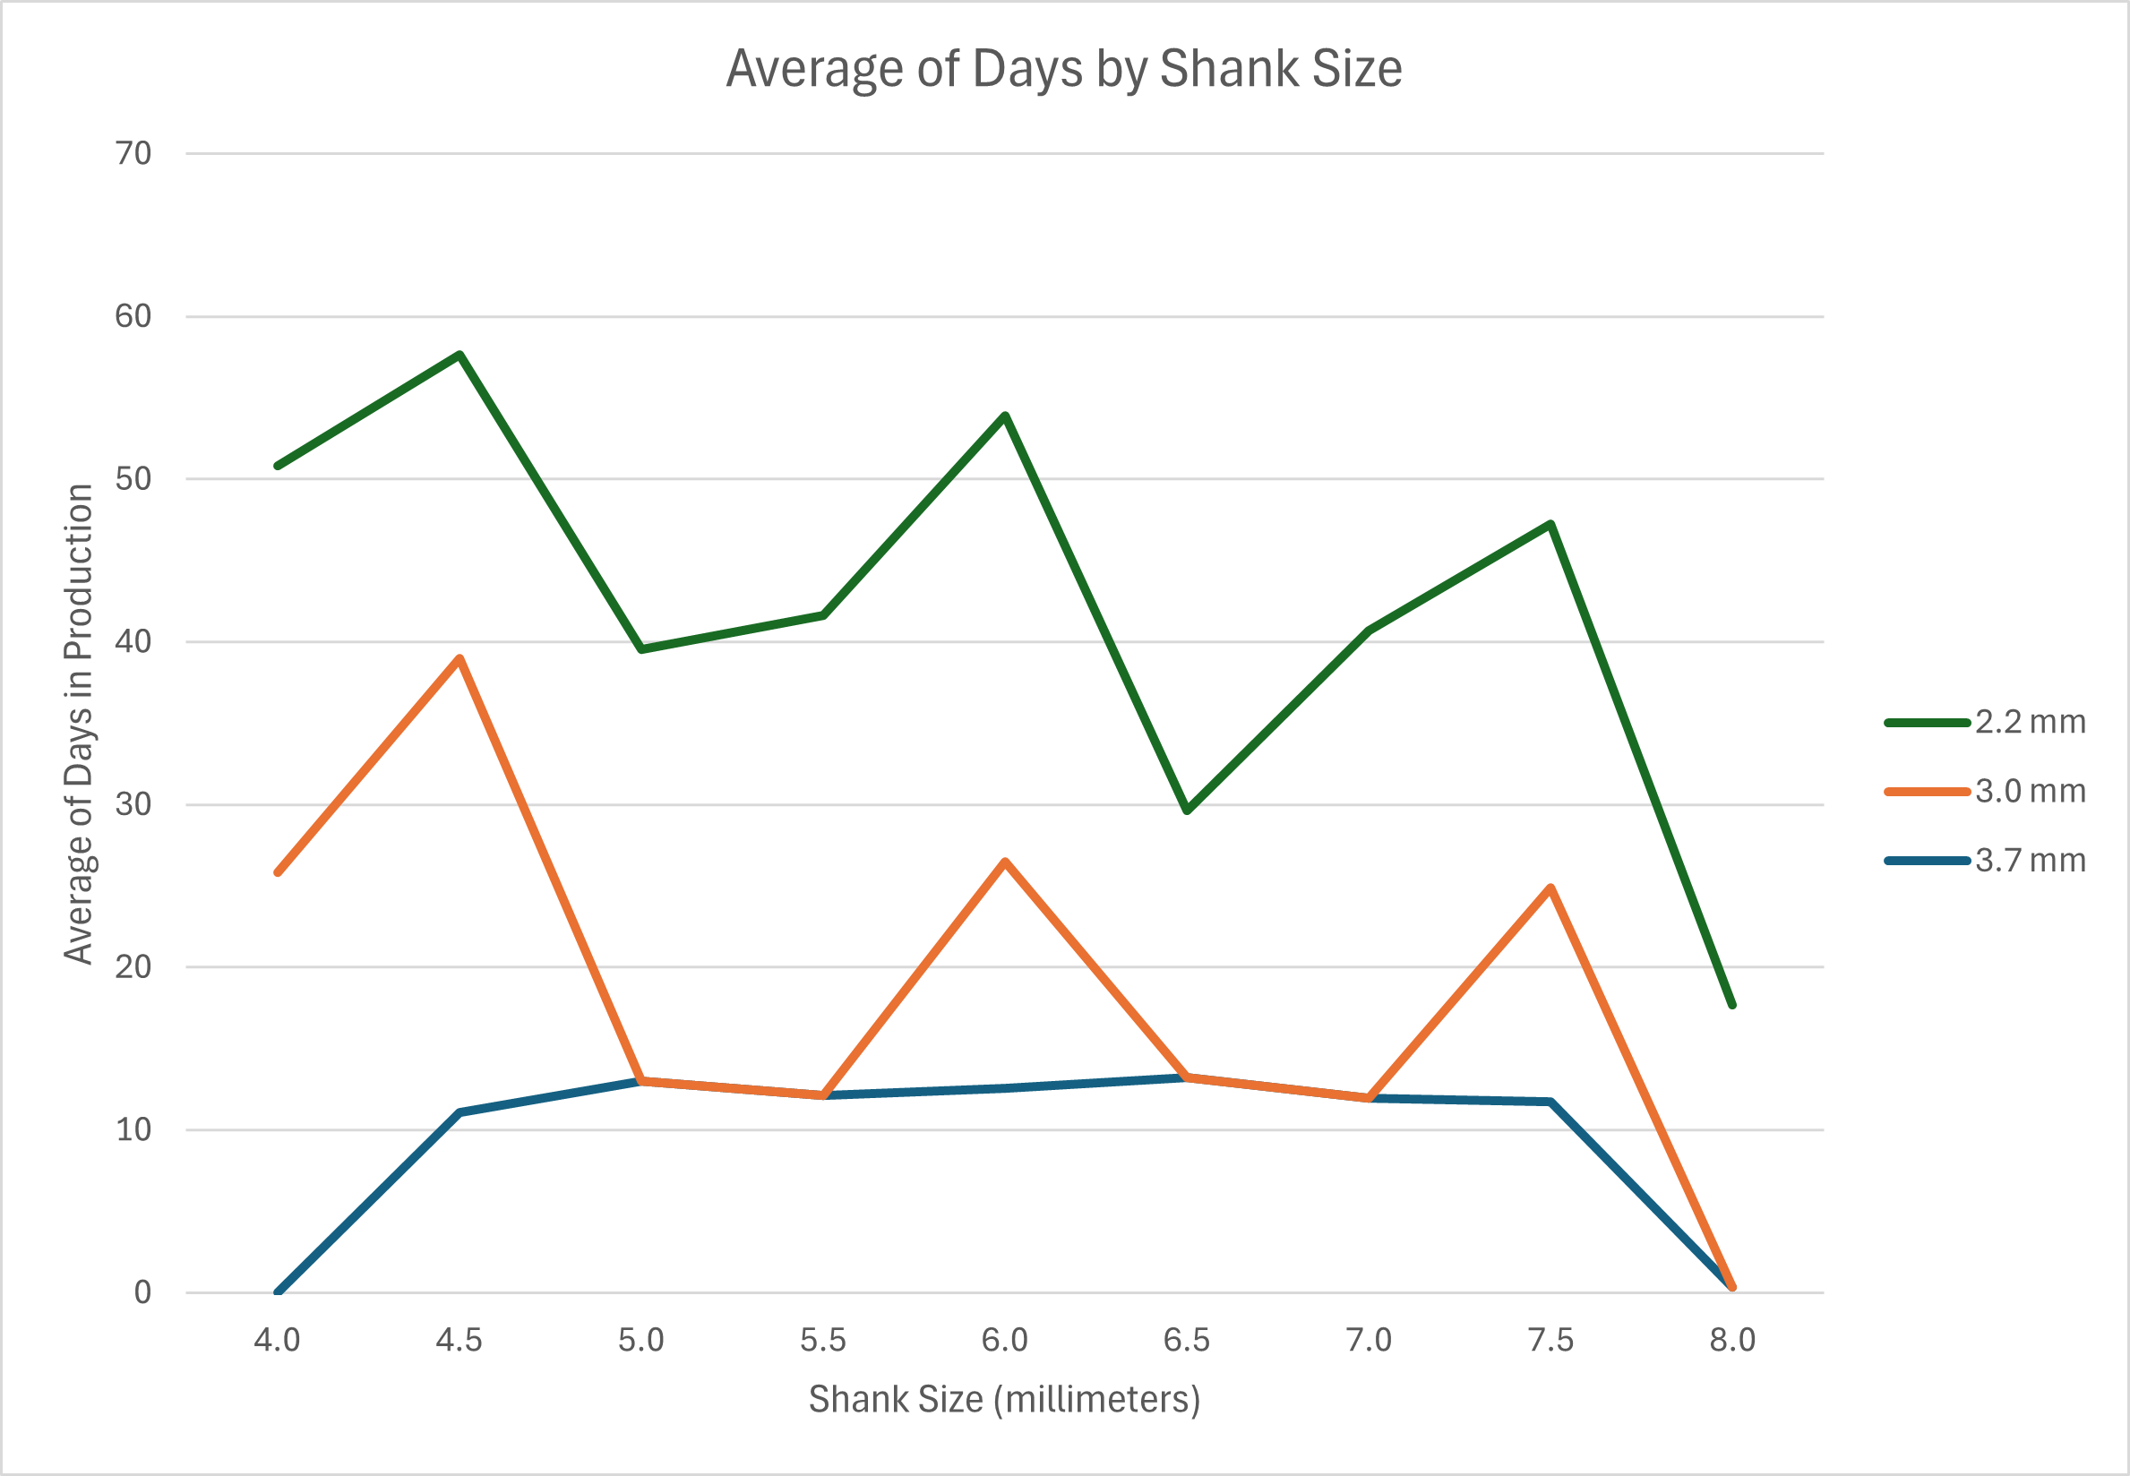

Slide 8
Observations of Volume Over Time

Slide 9
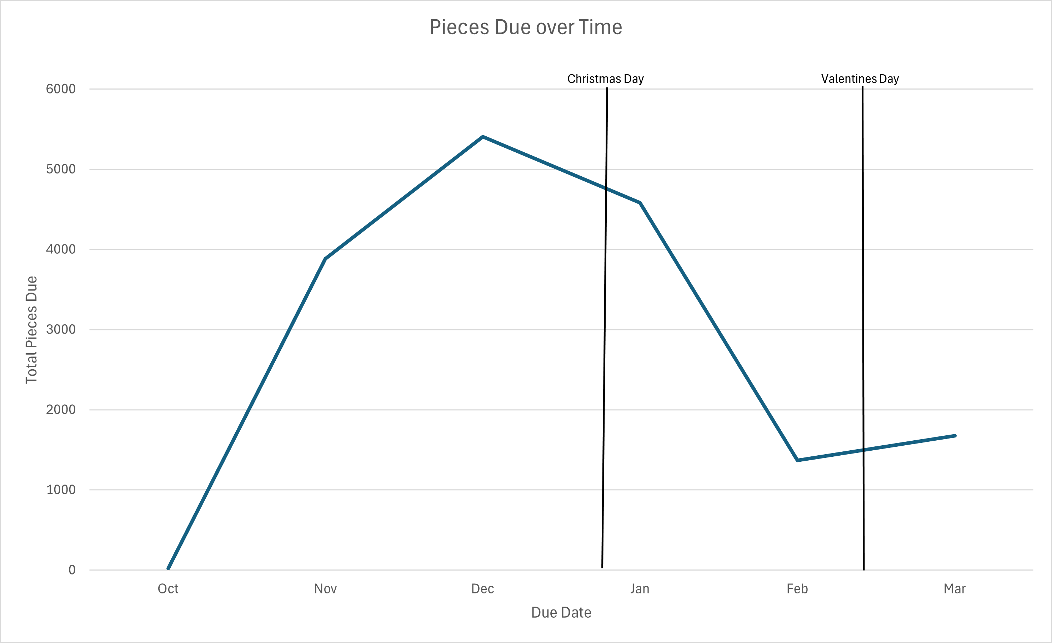

Slide 10
Observations of Factory Locations

Slide 11
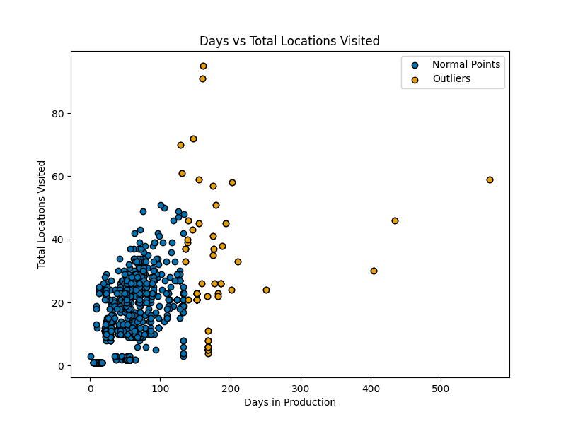

Slide 12
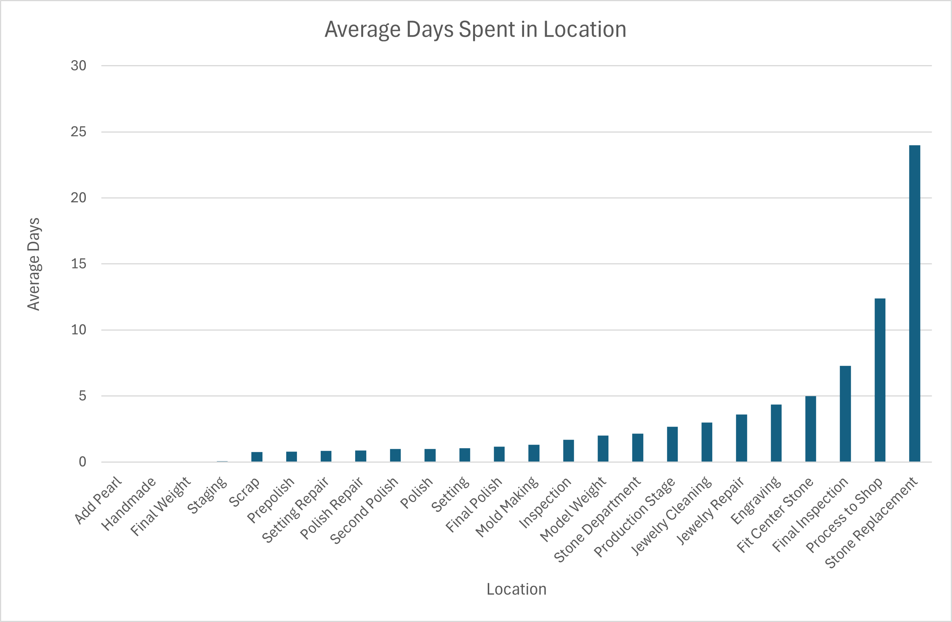

Slide 13
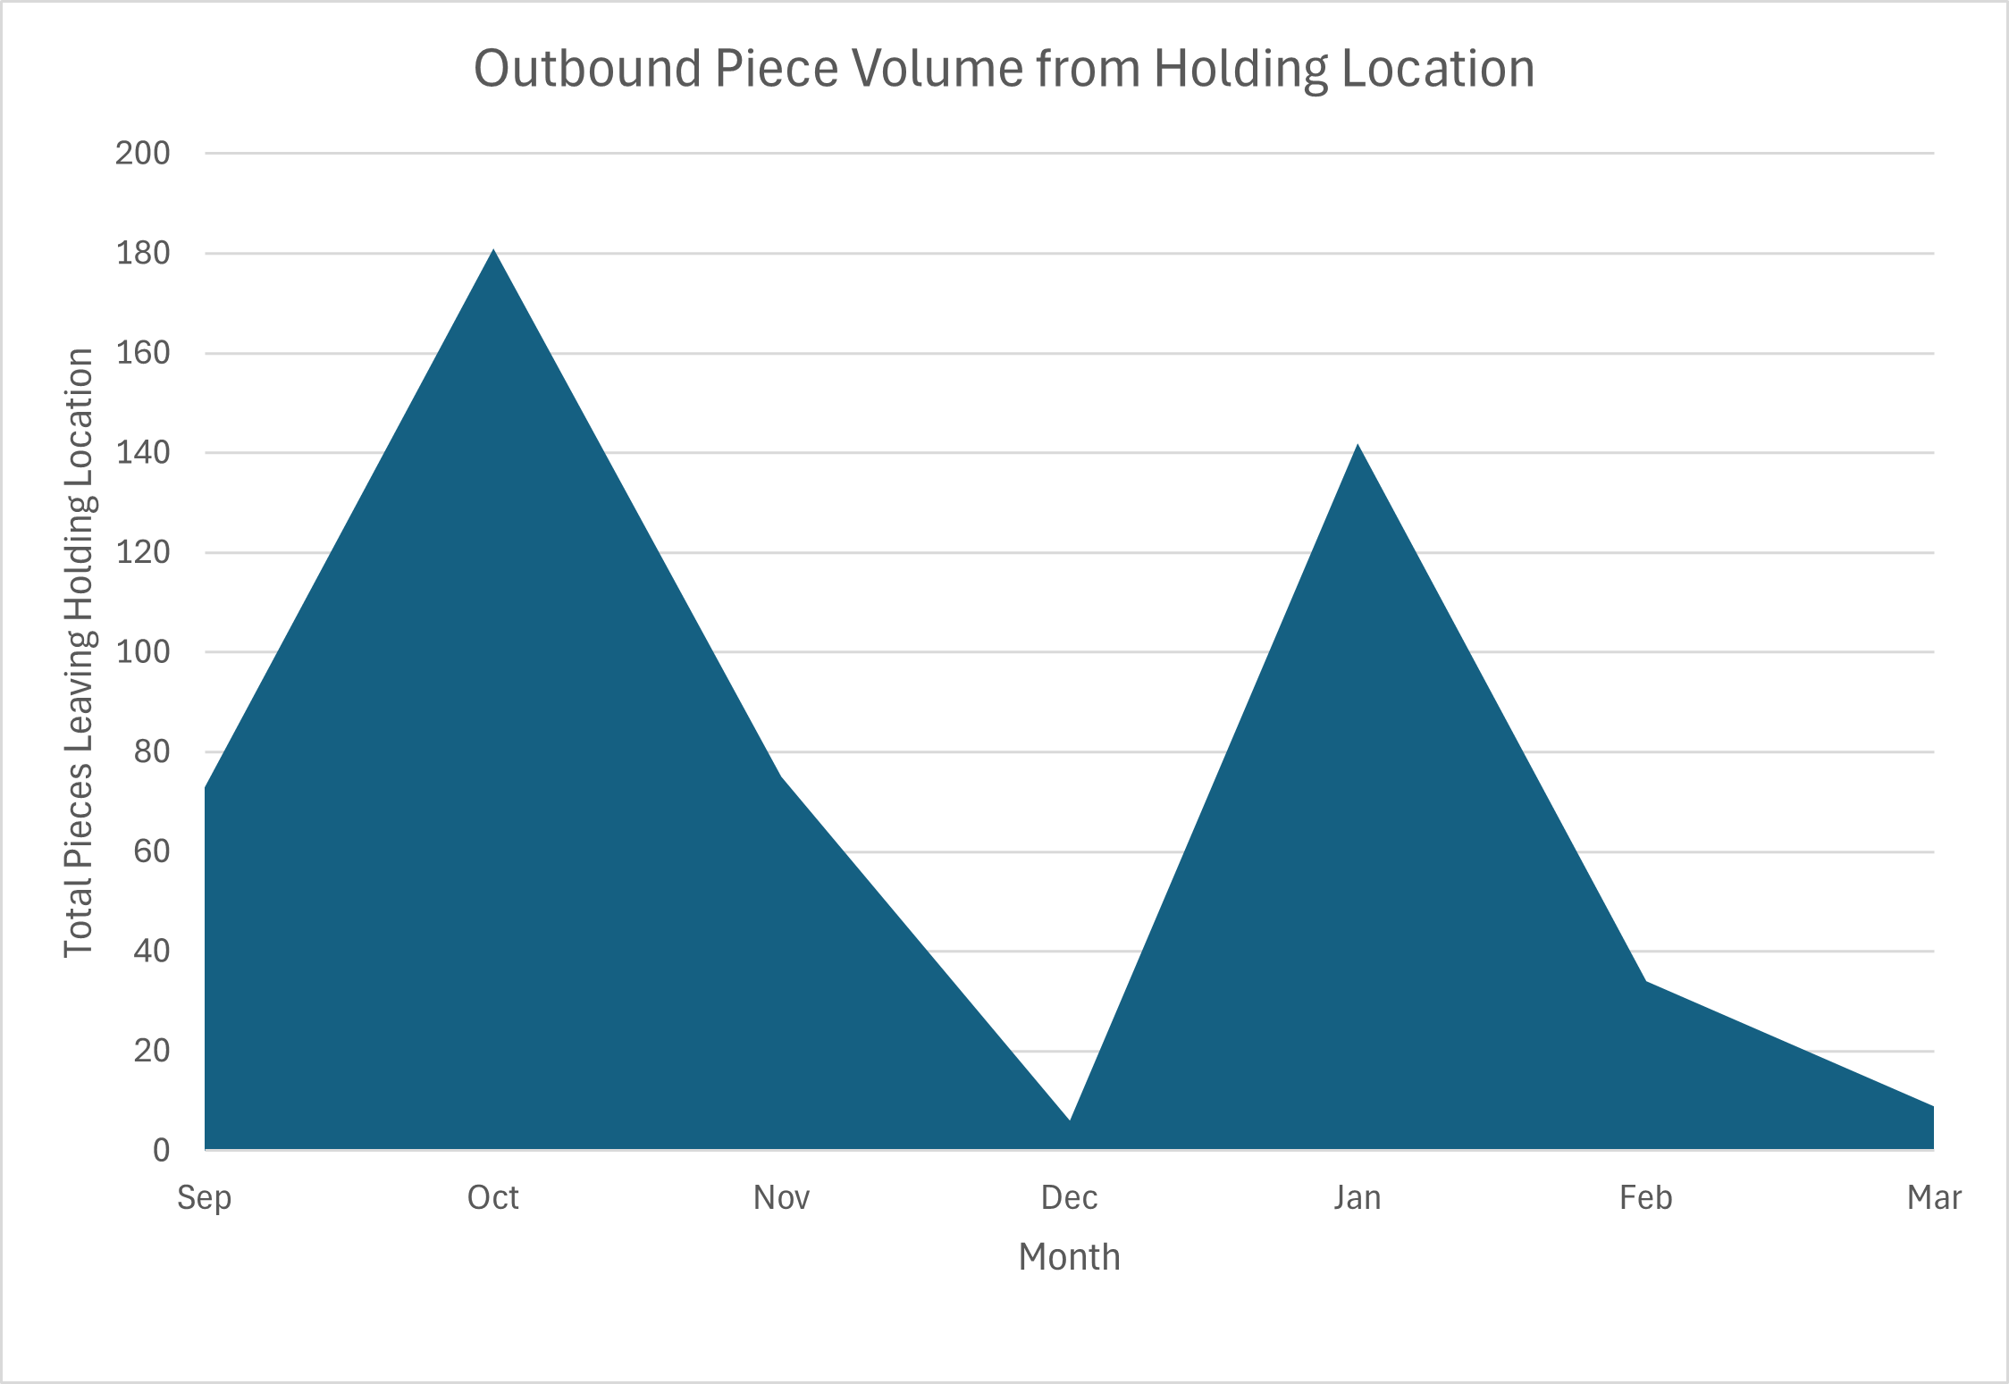

Slide 14
Bottlenecks Found
The Process to Shop holding location tends to have items sit in it for extended periods of time, waiting for a Jeweler to take the job
The Stone Replacement location takes long due to the need to source a new stone
Items tend to take longer in Final Inspection – this is likely a data recording errors for jobs that fail inspection
The high volume caused by the Holidays slows down production overall

Slide 15
Recommendations
Stock common stones shapes/sizes for use in common repairs to bring down stone replacement time
Create stock rings before October to prepare for holiday volume spike
Bring on more jewelers/setters/QC to move pieces out of the holding location and into production faster

